Slide 1
Polish Notations

Slide 2
Infix to Postfix Algorithm
Let A be infix expression, and B be an empty string which will hold the converted postfix expression
Push “(” onto STACK, and add “)” to end of the A
Scan A from left to right and repeat step 3 to 6 for each element of A
If an operand is encountered add it to B
If an “(“ is encountered push it onto the stack
If an operator 'op' is encountered then:
Repeatedly pop from STACK and add to B each operator (on the top of STACK) which has higher or equal precedence than the operator 'op'.
Add operator ‘op’ to STACK
If a right parenthesis is encountered then
Repeatedly pop from the STACK and add to B each operator from top of stack until a left parenthesis is encountered
Remove the left parenthesis
Stop

Slide 3
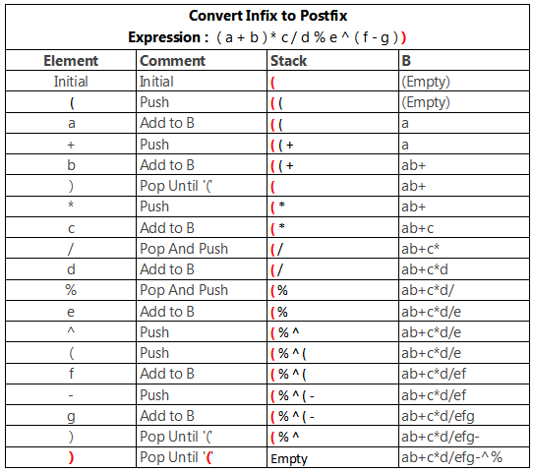

Slide 4
Example
(A+B^C)*D+E^5

Slide 5
Infix to Prefix Algorithm
Let A be infix expression, and B be an empty string which will hold the converted prefix expression
Push “)” onto STACK, and add “(” to start of the A
Scan A from right to left and repeat step 3 to 6 for each element of A
If an operand is encountered add it to B
If a right parenthesis is encountered push it onto STACK
If an operator 'op' is encountered then:
Repeatedly pop from STACK and add to B each operator (on the top of STACK) which has higher precedence than the operator 'op'.
Add operator ‘op’ to STACK
If a left parenthesis is encountered then
Repeatedly pop from the STACK and add to B each operator from top of stack until a right parenthesis is encountered
Remove the right parenthesis
Reverse B
Stop

Slide 6
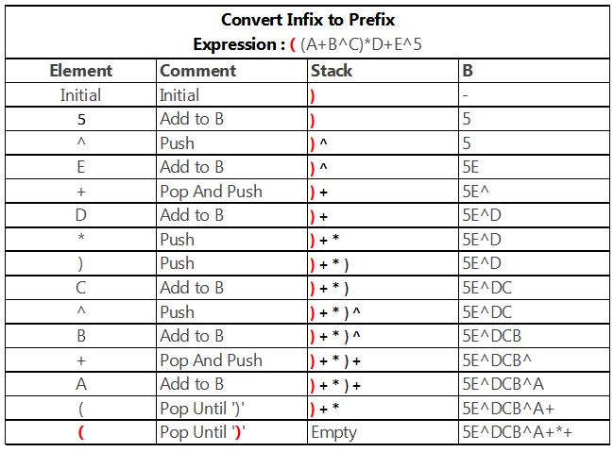

Slide 7
Evaluation of Postfix Expressions (Postfix to Infix)
Let A be Postfix expression, and S be an empty stack
Scan A from left to right and repeat step 2 to 3 for each element of A
If an operand is encountered push it in S
If an operator 'op' is encountered then:
Opnd1 = pop()
Opnd2 = pop()
Push ( opnd2 ‘op’ opnd1 ) in S
Pop and print/use the entity in S
Stop

Slide 8
Evaluation of Prefix Expressions (Prefix to Infix)
Let A be Prefix expression, and S be an empty stack
Scan A from right to left and repeat step 2 to 3 for each element of A
If an operand is encountered push it in S
If an operator 'op' is encountered then:
Opnd1 = pop()
Opnd2 = pop()
Push ( opnd1 ‘op’ opnd2 ) in S
Pop and print/use the entity in S
Stop

Slide 9
End

